Slide 1



Seaborn

Slide 2
Introduction
Seaborn is a Python statistical graphics library.
It builds on top of matplotlib and incorporates data structures closely with pandas.
Seaborn allows you to explore and understand your data.
Its plotting functions work on data frames and arrays containing entire datasets and internally perform the necessary semantic mapping and statistical aggregationfor the development of informative plots.
It makes the charts more appealing and promotes some of the common needs for data visualisation (like mapping a color to a variable).
Importing seaborn: import seaborn as sns
To check the version of seaborn on your system:
print(sns.__version__)

Slide 3
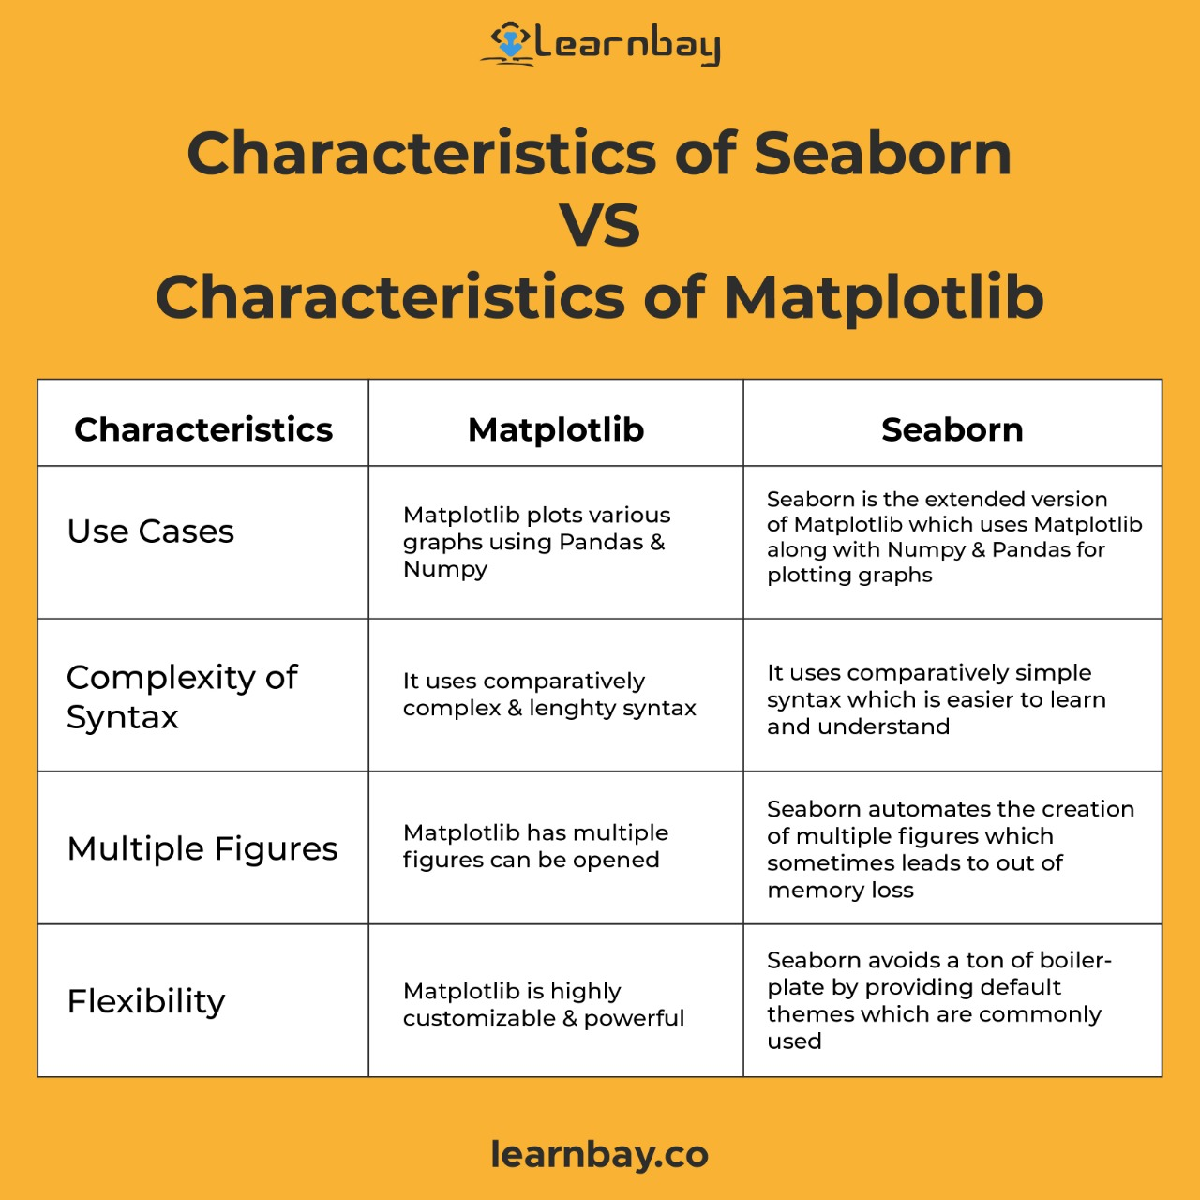

Slide 4
Interesting, right?
This is just a sneak preview of the full presentation. We hope you like it! To see the rest of it, just click here to view it in full on PowerShow.com. Then, if you’d like, you can also log in to PowerShow.com to download the entire presentation for free.

